Slide 1
Friend Zone: Liz Martinez, Greg Douglas, Jose Medina, and June Beaver
October 6, 2021

Slide 2









The World of Connection
Are we ready to connect?
Give us thumb up if you like

Slide 3



























Birds migration into our life circle
Exploration
Analyze
Ready for the tour?
Assimilation
Give us thumb up if you like

Slide 4
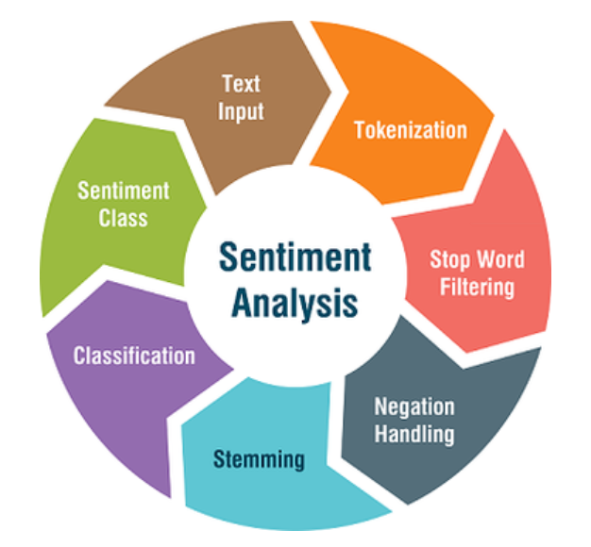

Realm of tweeps
Sentiment Classifier in Python
Naïve Bayes Classifier using NLTK (Natural Language toolkit) libraries – The tool provide the dataset that categorizes each review as positive or negative
Frequency Distribution
Extracting Concordance and Collocations
Popular NLP Sentiment analysis packages
VADER (Valence Aware Dictionary and sEntiment Reasoner): built-in pretrained sentiment analyzer
TextBlob: provide access to common text-processing operations through a familiar interface
SentiWordNet: an opinion lexicon derived from the WordNet database
Flair: embedding based python packages (classify vector for each synonymically similar words group)
# RiceFinTech, # FinTech
What is sentiment analysis?
Sentiment analysis is the task of determining the emotional value of a given expression in natural language.
Source: Medium, DataCamp, RealPython
Data Exploration
Notes:
Extracting Concordance and Collocations
How many times a word appears
Where each occurrence appears
What words surround each occurrence

Slide 5
Realm of tweeps
Data Exploration

Slide 6
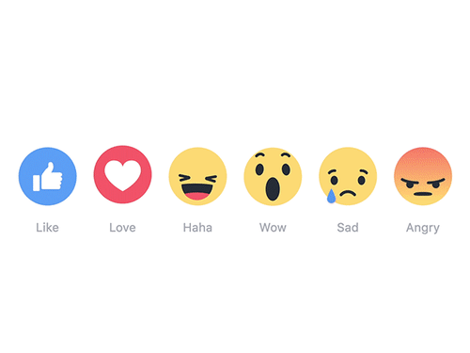






Memoji Feelings
Impact Analysis

Slide 7
Memoji Feelings
Impact Analysis

Slide 8
Happily Ever After (may be not?)
Assimilation

Slide 9
Happily Ever After (may be not?)
Assimilation

